Slide 1

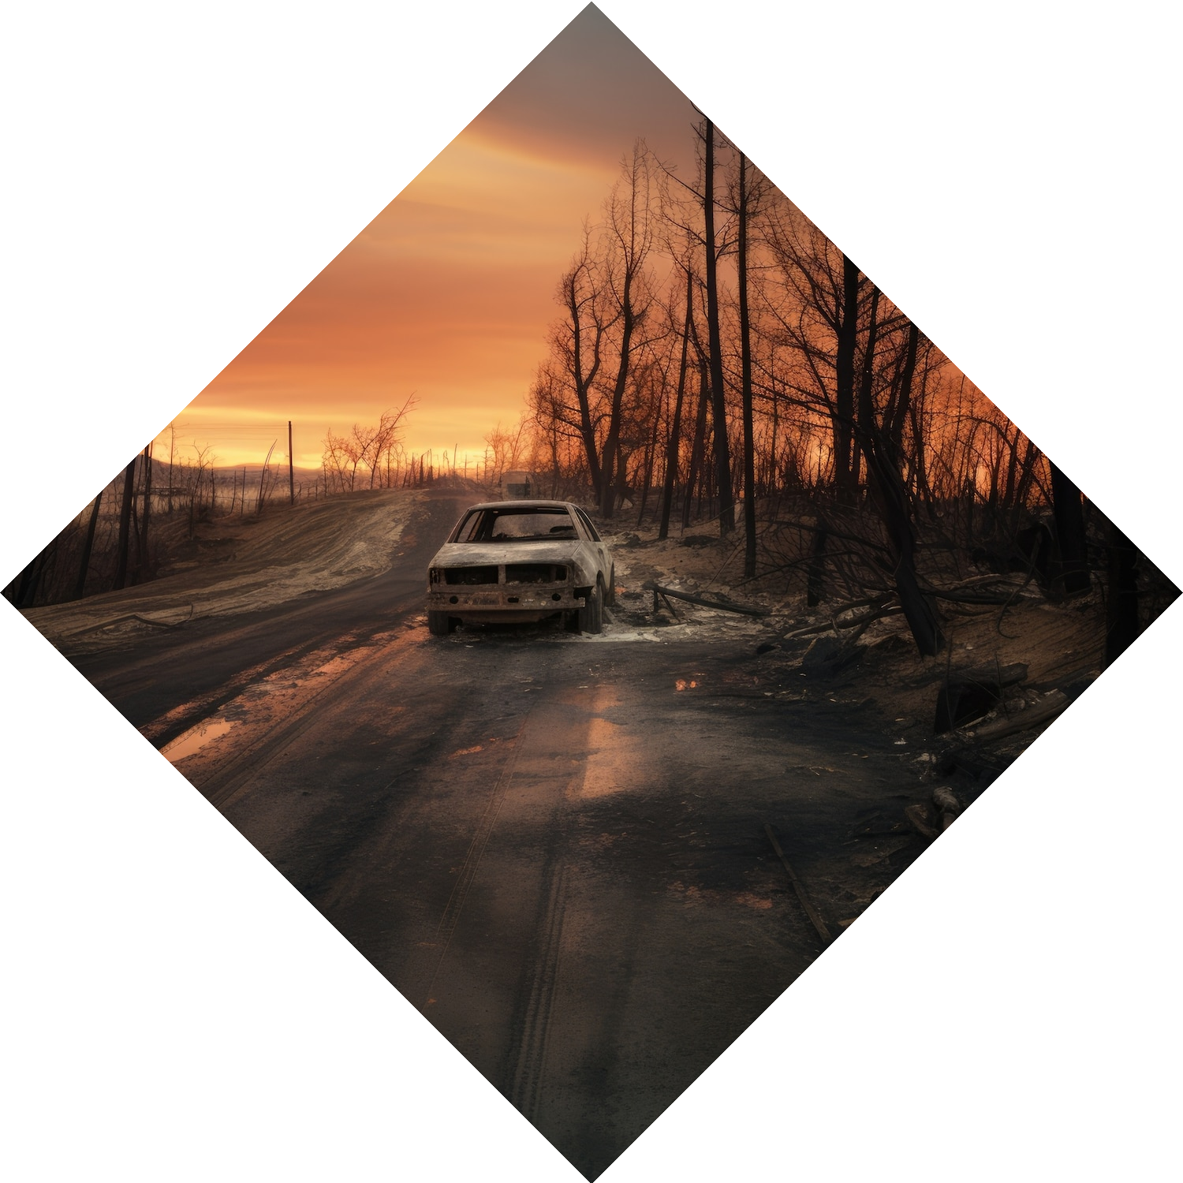
Vehicle Cut-in Detection

Slide 2

Problem Statement
•Current State-Of-The-Art (SOTA) solutions for automotive collision avoidance work by:
•Vehicle detection
•Distance estimation
•Time-to-collision(TTC) calculation (using vehicle speed data from GPS or Engine)
•They then warn the driver or apply the brakes (if supported) when the TTC drops below a predefined threshold
•This method has one limitation:
•The vehicle needs to be in front of the driver to be detected •Vehicles that abruptly cut into the driver’s path typically are not considered for collision avoidance

Slide 3

Unique Idea Brief
Creating a path of direction based on vehicle movement and detecting lanes and vehicles inside a frame
Distance calculation between two models
Detecting Vehicle Cut-In
Vehicle collision warning Generation

Slide 4

Features Offered
A ML model for detecting cut-ins.
True positives

Slide 5
Process Flow
Step 1: Analyzing Vehicle Movement and Detecting Lanes and Vehicles
Frame Capture and Preprocessing.
Capture frames from the video stream or camera input.
Preprocess the frames (resize, normalize, etc.).
Lane Detection
Vehicle Detection
Use a pre-trained deep learning model (e.g., YOLO, SSD) to detect vehicles in each frame
Apply non-max suppression to eliminate duplicate detections
Track detected vehicles across frames using object tracking algorithms (e.g., SORT, DeepSORT).Path of Direction Analysis
Analyze the trajectory of each detected vehicle over multiple frames.
Calculate the direction vector based on the movement between consecutive frames.

Slide 6
Step 2: Distance Calculation Between Two Models
Extract Vehicle Coordinates
Extract the bounding box coordinates of each detected vehicle.
Calculate Distance
Convert pixel coordinates to real-world coordinates using camera calibration parameters.
Calculate the Euclidean distance between the centroids of two detected vehicles.
Step 3: Detecting Vehicle Cut-In
Identify Potential Cut-In Scenarios
Monitor the lateral distance between vehicles in adjacent lanes.
Check for rapid lateral movement towards another lane (potential cut-in).Analyze Cut-In Behavior
Determine the speed and angle of the cut-in vehicles.
Assess the risk based on the relative speed and distance between the cut-in vehicle and the surrounding vehicles.
Step 4: Vehicle Collision Warning Generation
Risk Assessment
Use the calculated distances and speed differentials to assess collision risk.
Implement a risk threshold to trigger warnings.
Collision Warning Generation
Generate visual warnings when the risk exceeds the threshold.
Optionally, send signals to the vehicle’s braking or steering systems for collision avoidance (in advanced driver-assistance systems).

Slide 7
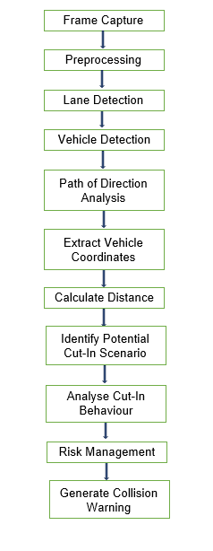
Architecture Diagram

Slide 8
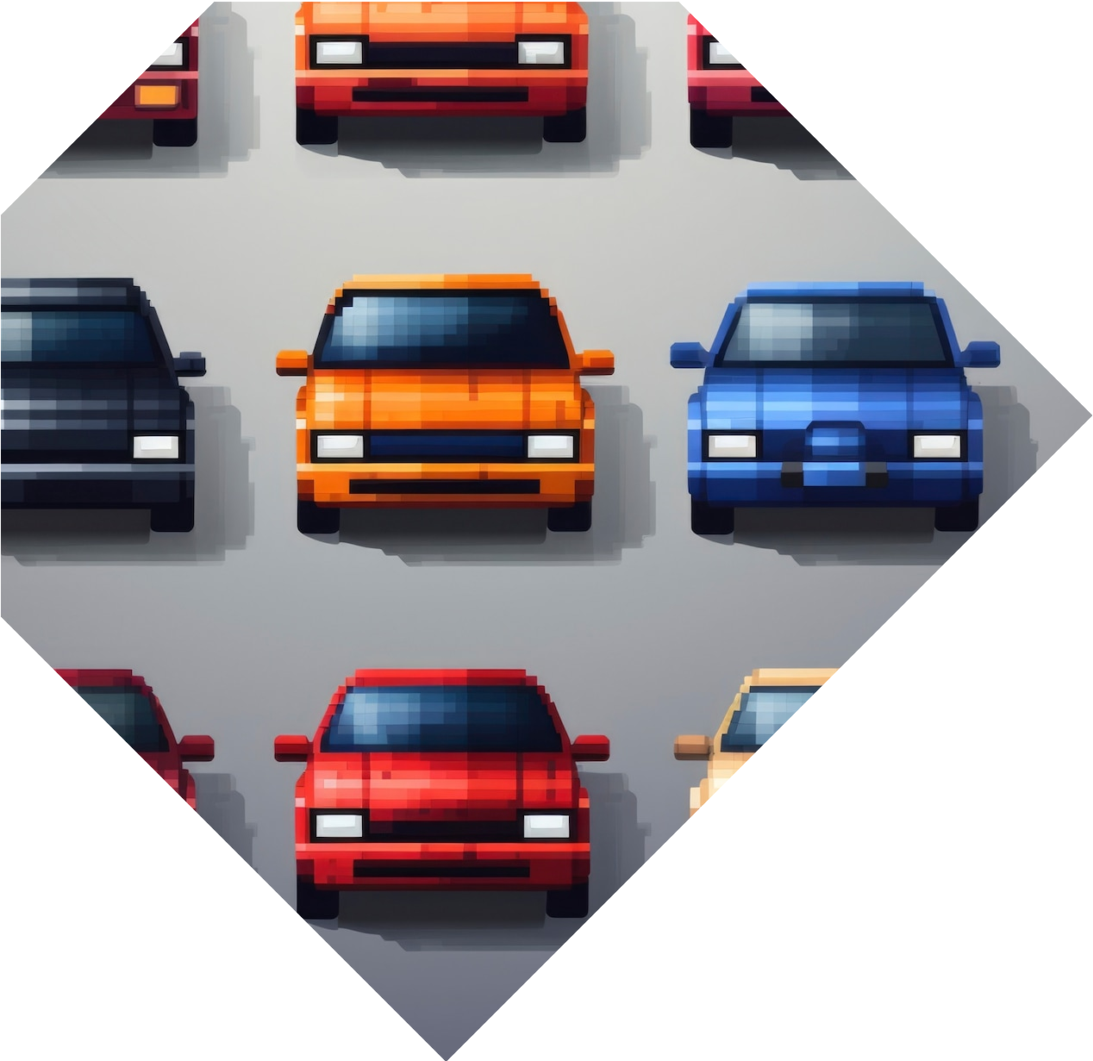
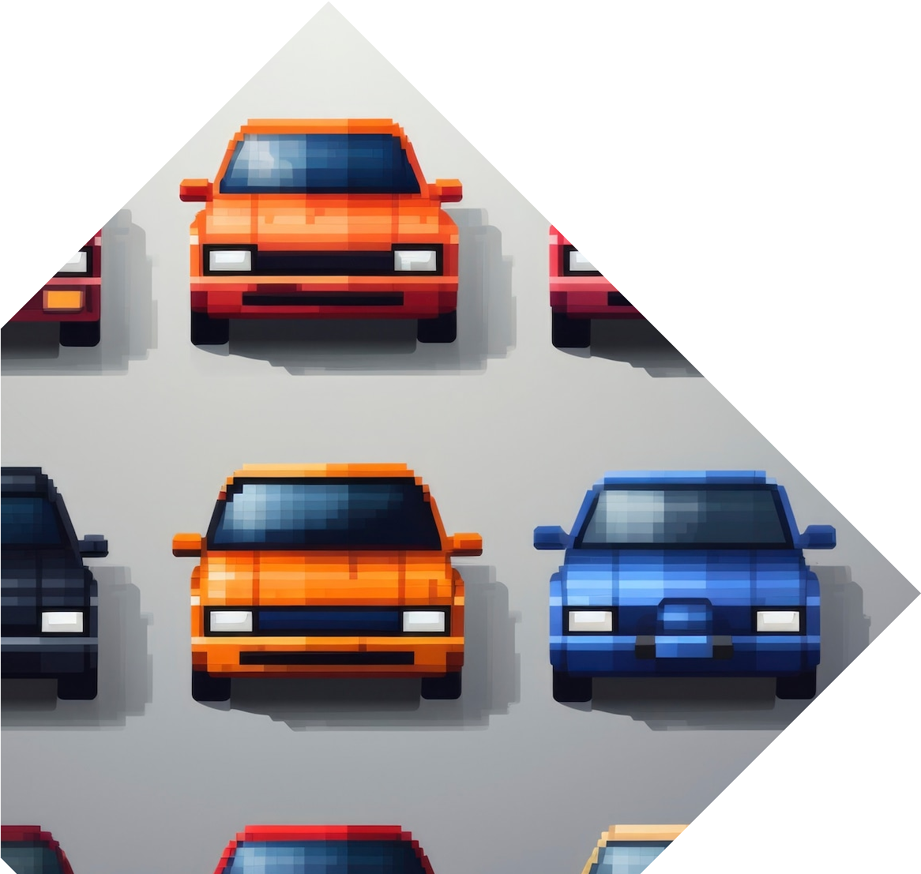
Technologies Used
Python libraries used :-
cv2
numpy
math
torch
pandas
subprocess
moviepy.editor
matplotlib
collections
pytube
yolov5 model

Slide 9

Team Members & Contributions
Team Member 1 (Surbhi Sharma) : Vehicle detection and Bounding Box Generation, Preprocessing the dataset
Team Member 2 (Srishti Agarwal) : Distance Estimation And Warning Generation

Slide 10
Conclusion
The vehicle cut-in detection project successfully developed a robust system using YOLOv5 and the IDD dataset. Despite challenges related to data quality and environmental factors, the model demonstrated high accuracy and real-time performance. Future work will focus on further improving detection accuracy under varying weather conditions and exploring more advanced trajectory prediction algorithm.
This report covers the technical approach, issues faced, and results of the vehicle cut- in detection project. Each section provides detailed insights into the methods and challenges encountered, ensuring a comprehensive understanding of the project's development and outcomes.

Slide 11
Thanks!
Surbhi Sharma
Srishti Agarwal

